Slide 1
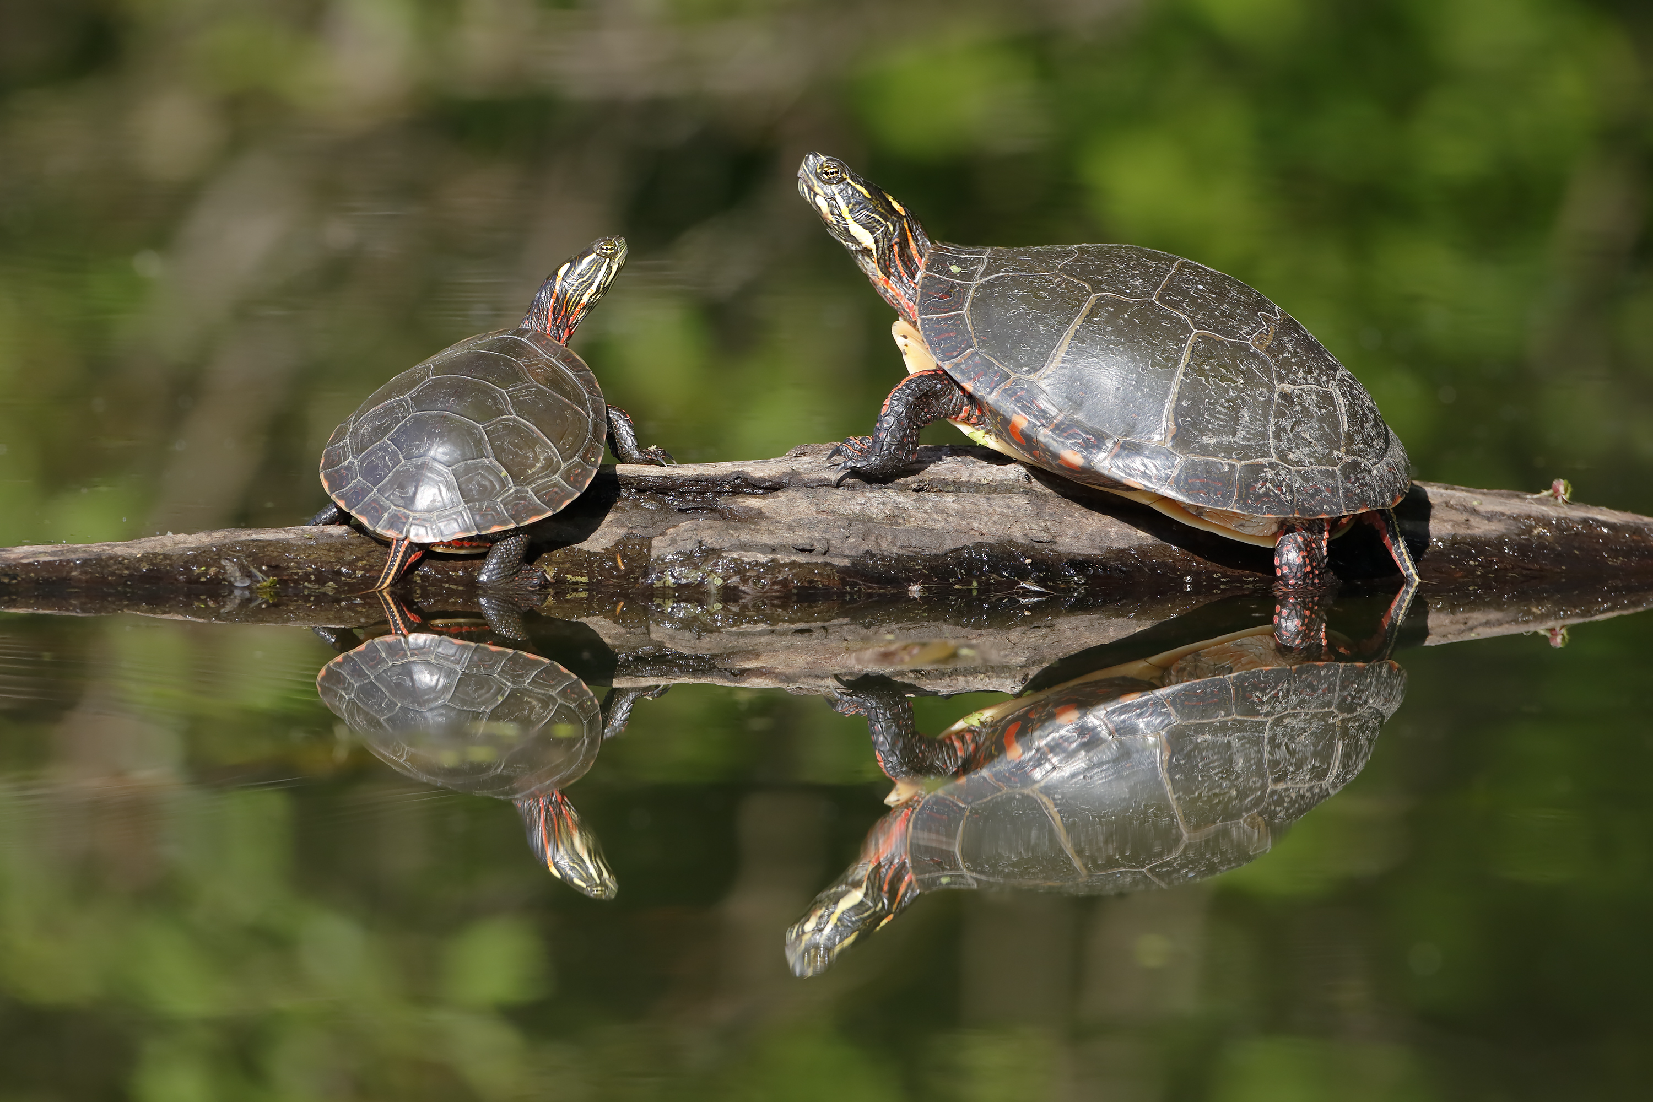
Logging
Log4J
Loggers
Levels
Layouts and Appenders

Slide 2

See Also
https://en.wikipedia.org/wiki/Java_logging_framework
http://logging.apache.org/log4j/2.x/
https://www.youtube.com/watch?v=-GkRuFU_sUg
Notes:
Some additional information on concurrency

Slide 3


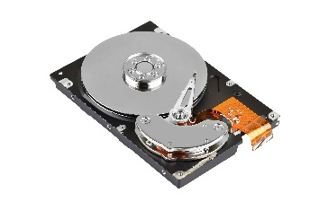
Logging
Logger
Layout
Appender
FATAL
Utility
Console
INFO
WARN
WARN
Servlets
DEBUG
Email
FATAL
Database
DEBUG
Disk File

Slide 4
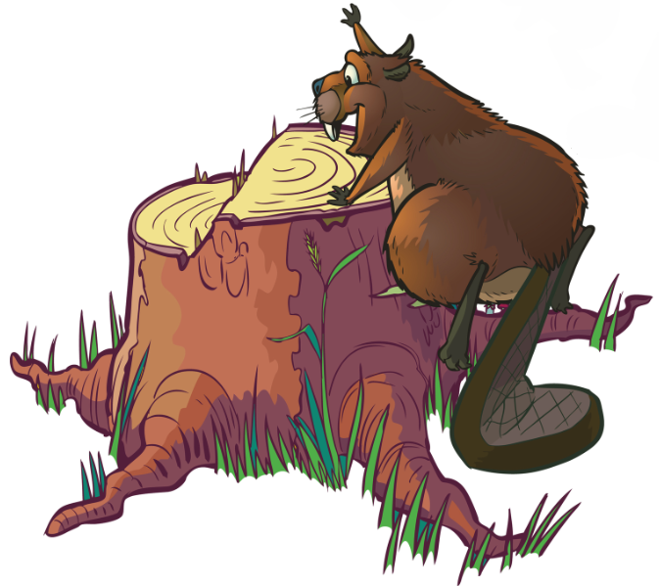
Logging
Loggers receive the information from the code
Message, Code location, Severity, Exception
Appenders route the logs to a physical destination
Log file, email, console, syslog, database
Layouts format the information for the destination
Order and format of the information

Slide 5

Pick Your Framework
Java Logging API (shipped with the JVM since 1.4)
Log4J 1 and 2 (Apache project)
SLF4J (From the father of Log4J)
Many others (many are interchangeable)

Slide 6
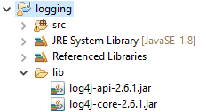
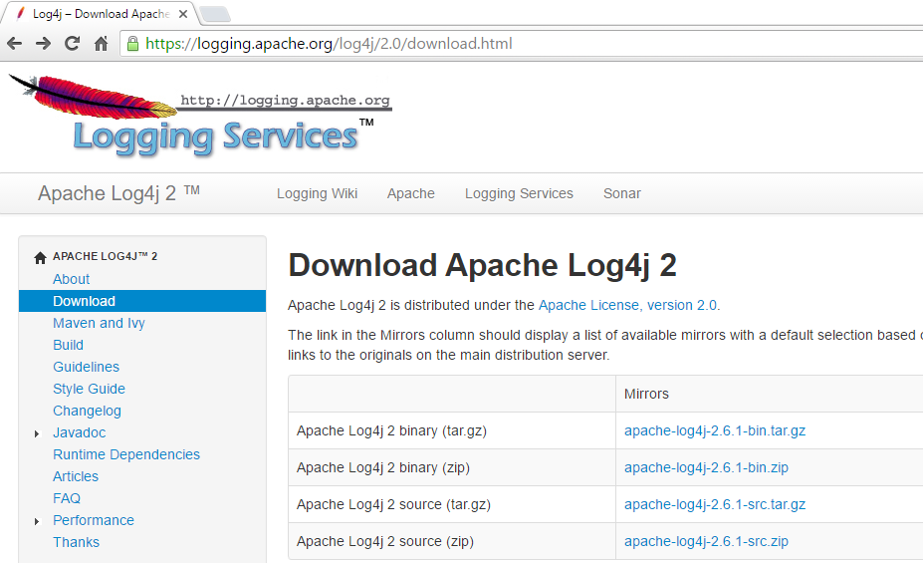
Log4J Jars

Slide 7
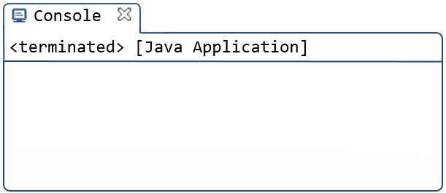
Simple Example
import org.apache.logging.log4j.LogManager;
import org.apache.logging.log4j.Logger;
public class Tinker {
public static void main(String[] args) {
Logger a = LogManager.getLogger("fred");
Logger b = LogManager.getLogger("sue");
a.fatal("Fatal");
b.error("Error");
b.warn("Warn");
b.info("Info");
b.debug("Debug");
b.trace("Trace");
}
}
ERROR StatusLogger No log4j2 configuration file found. Using default configuration: logging only errors to the console.
17:44:29.272 [main] FATAL fred - Fatal
17:44:29.273 [main] ERROR sue - Error

Slide 8
log4j2.xml
<?xml version="1.0" encoding="UTF-8"?>
<Configuration>
<Appenders>
<Console name="To The Console" target="SYSTEM_OUT">
<PatternLayout pattern="%d{HH:mm:ss.SSS} [%t] %-5level %logger{36} - %msg%n"/>
</Console>
</Appenders>
</Configuration>
Unique name
Parameter to appender
Date/Time
New Line
Name of thread
Message
Level (padded)
Name of logger

Slide 9
log4j2.xml
<?xml version="1.0" encoding="UTF-8"?>
<Configuration>
<Appenders>
<Console name="To The Console" target="SYSTEM_OUT">
<PatternLayout pattern="%d{HH:mm:ss.SSS} [%t] %-5level %logger{36} - %msg%n"/>
</Console>
</Appenders>
<Loggers>
<Root level="warn">
<AppenderRef ref="To The Console"/>
</Root>
<Logger name="sue" level="debug" additivity="false">
<AppenderRef ref="To The Console"/>
</Logger>
</Loggers>
</Configuration>
warn, error, fatal
Name of appender
Don’t share with other loggers
debug, info, warn, error, fatal

Slide 10
Loggers in Action
Logger a = LogManager.getLogger("fred");
Logger b = LogManager.getLogger("sue");
a.fatal("Fatal");
a.error("Error");
a.warn("Warn");
a.info("Info");
a.debug("Debug");
a.trace("Trace");
b.error("Error");
b.warn("Warn");
b.info("Info");
b.debug("Debug");
b.trace("Trace");
<Loggers>
<Root level="trace">
<AppenderRef ref="To The Console"/>
</Root>
</Loggers>
19:54:56.992 [main] FATAL fred - Fatal
19:54:56.994 [main] ERROR fred - Error
19:54:56.994 [main] WARN fred - Warn
19:54:56.994 [main] INFO fred - Info
19:54:56.994 [main] DEBUG fred - Debug
19:54:56.994 [main] TRACE fred - Trace
19:54:56.994 [main] ERROR sue - Error
19:54:56.994 [main] WARN sue - Warn
19:54:56.994 [main] INFO sue - Info
19:54:56.994 [main] DEBUG sue - Debug
19:54:56.994 [main] TRACE sue - Trace

Slide 11
Loggers in Action
Logger a = LogManager.getLogger("fred");
Logger b = LogManager.getLogger("sue");
a.fatal("Fatal");
a.error("Error");
a.warn("Warn");
a.info("Info");
a.debug("Debug");
a.trace("Trace");
b.error("Error");
b.warn("Warn");
b.info("Info");
b.debug("Debug");
b.trace("Trace");
<Root level="warn">
<AppenderRef ref="To The Console"/>
</Root>
<Logger name="sue" level="debug" additivity="false">
<AppenderRef ref="To The Console"/>
</Logger>
19:56:24.809 [main] FATAL fred - Fatal
19:56:24.810 [main] ERROR fred - Error
19:56:24.810 [main] WARN fred - Warn
19:56:24.810 [main] ERROR sue - Error
19:56:24.810 [main] WARN sue - Warn
19:56:24.810 [main] INFO sue - Info
19:56:24.810 [main] DEBUG sue - Debug

Slide 12
Loggers in Action
<Console name="LotsOfInfo" target="SYSTEM_OUT">
<PatternLayout pattern="%C %M %L %msg %n"/>
</Console>
<Root level="warn">
<AppenderRef ref="To The Console"/>
</Root>
<Logger name="sue" level="debug" additivity="false">
<AppenderRef ref="To The Console"/>
</Logger>
<Logger name="fred" level="trace" additivity="false">
<AppenderRef ref="LotsOfInfo"/>
</Logger>
Logger a = LogManager.getLogger("fred");
Logger b = LogManager.getLogger("sue");
a.fatal("Fatal");
a.error("Error");
a.warn("Warn");
a.info("Info");
a.debug("Debug");
a.trace("Trace");
b.error("Error");
b.warn("Warn");
b.info("Info");
b.debug("Debug");
b.trace("Trace");
Tinker main 11 Fatal
Tinker main 12 Error
Tinker main 13 Warn
Tinker main 14 Info
Tinker main 15 Debug
Tinker main 16 Trace
20:03:37.256 [main] ERROR sue - Error
20:03:37.256 [main] WARN sue - Warn
20:03:37.256 [main] INFO sue - Info
20:03:37.256 [main] DEBUG sue - Debug

Slide 13

Appenders
Console System.out or System.err
File Simple output file
Rolling File A log file that rolls after n days or m bytes
SMTP Send an email
Syslog Send to a syslog server
JDBC Store in a database table
Many others In Log4J
Many others From the community
Write your own Extend AppenderSkeleton

Slide 14
Logger Hierarchy
You can organize loggers into hierarchies
Use dots in the name (like the classpath)
“a.b.c” is under “a.b” which is under “a” which is under the root “”
A logger name in the XML file will pick up all children by default
<Logger name="a" level="trace" additivity="false">
<AppenderRef ref="LotsOfInfo"/>
</Logger>
a.b
a.b.c
a.b.c.d
a...

Slide 15

Using the Full Class Name
A common name/use scheme:
Use one logger per CLASS (a static member)
Use the class name as the logger’s name

Slide 16
Class Loggers
public class Point {
private static Logger log = LogManager.getLogger("com.widget.graphics.Point");
public void setX(int value) {
log.debug("Setting X to "+value);
}
}
private static Logger log = LogManager.getLogger();
<Logger name="com.widget" level="fatal" ...
<Logger name="com.widget.graphics" level="warn" ...
<Logger name="com.widget.graphics.Point" level="debug" ...

Slide 17
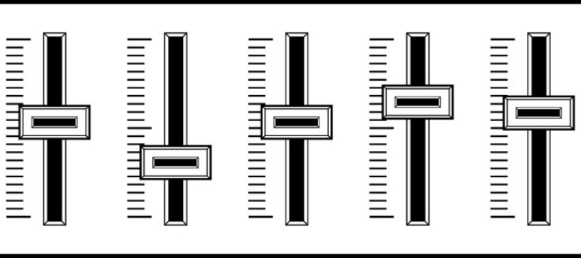
Automatic Reload
The “monitorInterval” tells log4j to check for config-file changes
You can change logging parameters on the fly without restarting
Crank up debug momentarily
Focus in on logs from a misbehaving package
<Configuration monitorInterval="30">
</Configuration>
30 seconds
(minimum is 5)

Slide 18
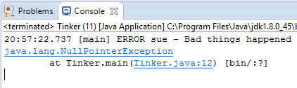
Logging Exceptions
public static void main(String[] args) {
Logger a = LogManager.getLogger("sue");
try {
String s = null;
s.length();
} catch (Exception e) {
a.error("Bad things happened", e);
}
}

Slide 19

Tinkering
Type in the “Sue” and “Fred” code from this lesson.
Experiment with levels, layouts, and appenders.
Add logging to one of your previous exercises.

